Slide 1


BNPL
BNPL Merchant
On-boarding Model
Group 8

Slide 2
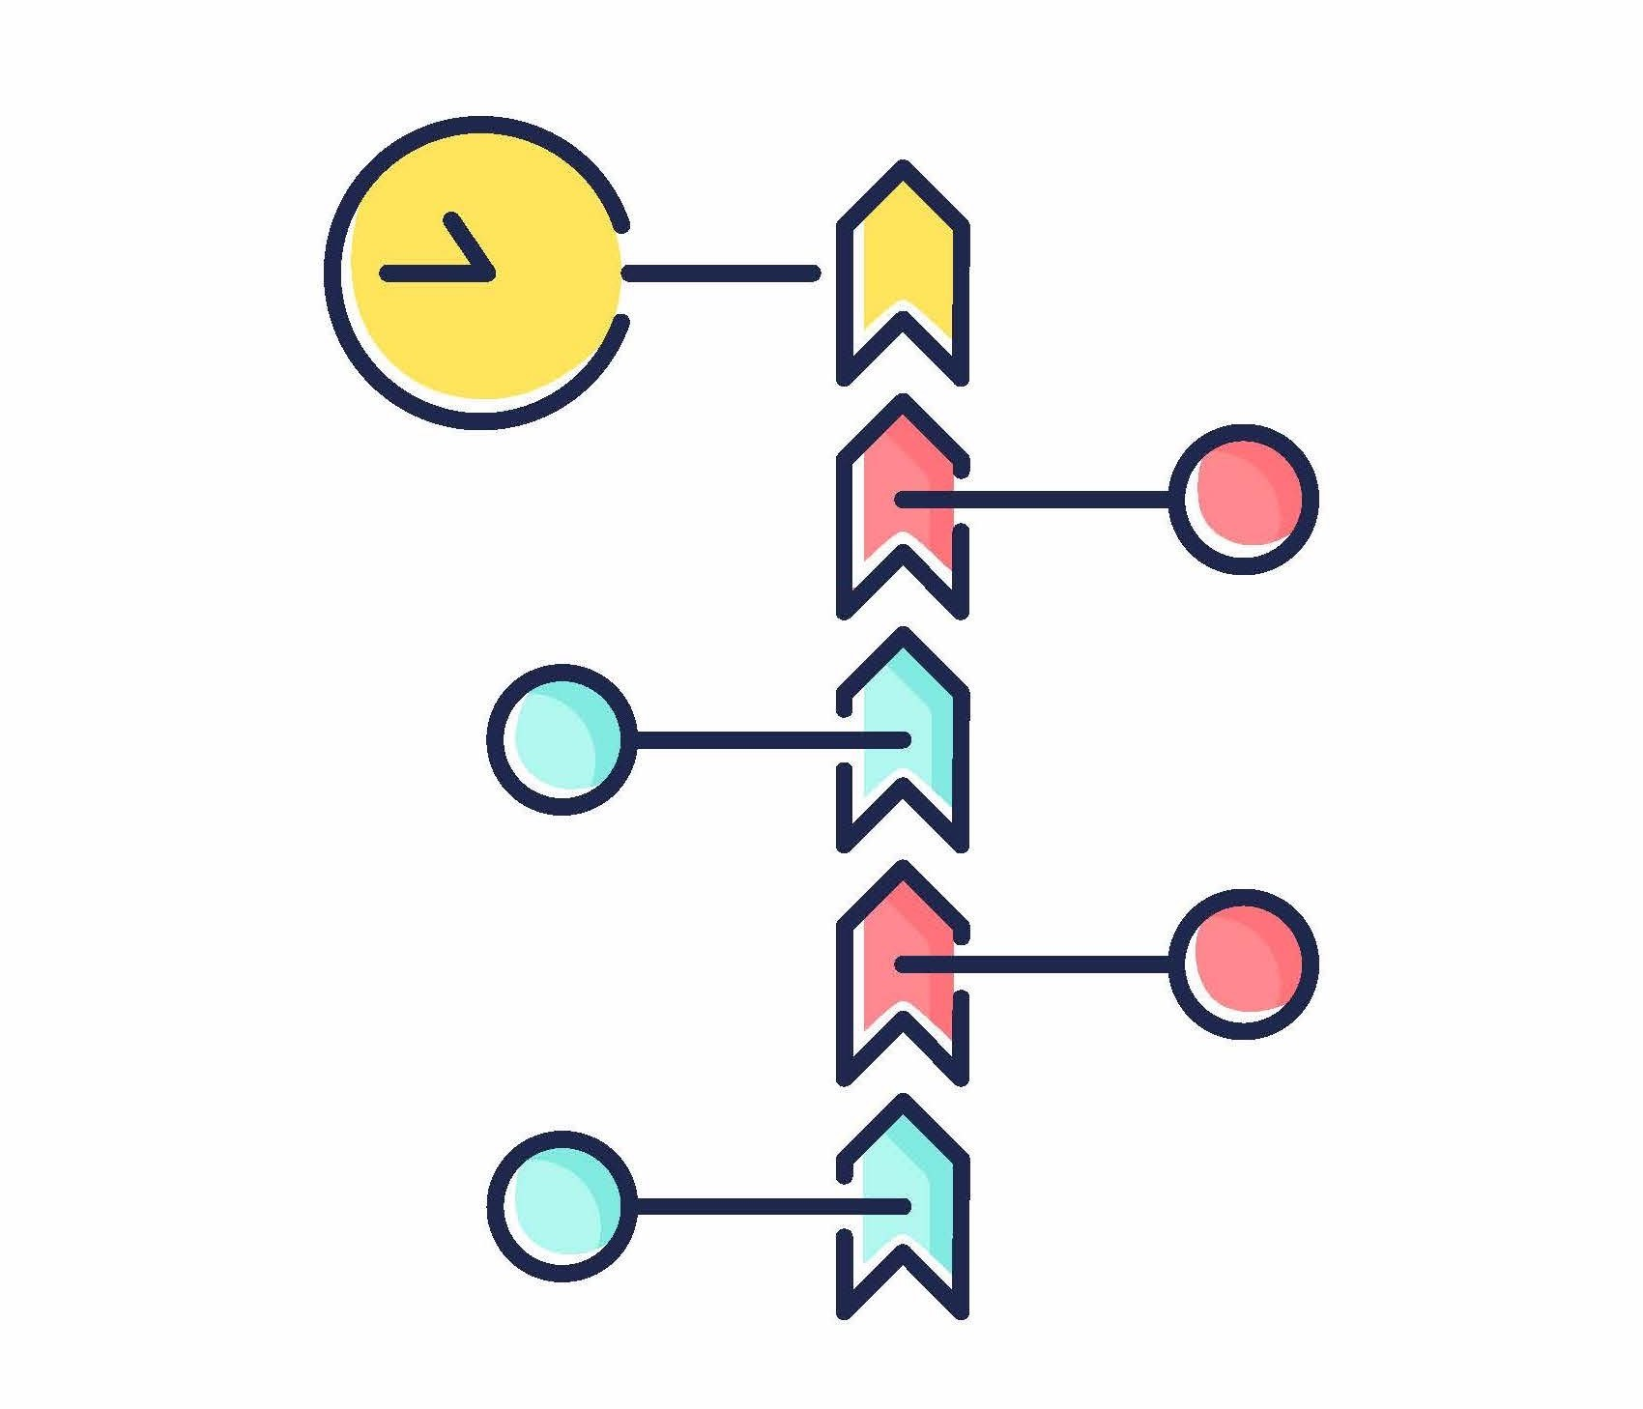

Lang (Ron) Chen
70%
Un Leng (Anderson) Kam
50%
Team Members
Haiyang (Henry) Huang
40%
Qirui (Cindy) Li
20%
Yujie Li
20%

Slide 3
Academic Calendar Week 7 – Week 11
Timeline
Week 1 | Week 2 | Week 3 | Week 4 | Week 5 | Week 6
Provided Data
Preliminary Analysis
Data Aggregation
External Dataset
Research for External Dataset
ABS to Persona Feature
Data Analysis
Fraud Model
Cluster Algorithm
Final Model
Final Model
An average of 15-20 hours per week each into this task

Slide 4



Collaboration Tools
Trello
Zoom
GitHub

Slide 5

Our Business Goal
What is the Problem?
1.
Stable Return
Selecting Merchants for a BNPL Firm Under Limited Resources
2.
Long-Term Expansion

Slide 6

Fraud
$$loss per fraud order>\left[take rate −\left(1−first instalment percent\right)\right]∗transaction amount$$
$$=[take rate −\left(1−\frac{1}{5}\right)]∗transaction amount$$

Slide 7

Features | F scores
Dollar value per order ratio | 44060.56
Dollar value per order | 39514.16
Std of Dollar value per order | 13292.88
Std of Dollar value per order ratio | 9811.99
Number of distinct merchant ratio | 47.89
Number of distinct merchants | 47.05
Number of daily orders ratio | 3.97
Number of daily orders | 3.68
Fraudulent Probability
Features

Slide 8
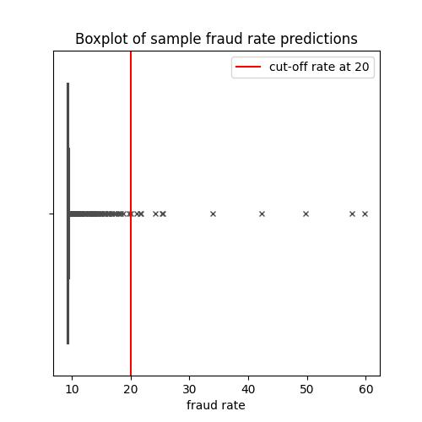
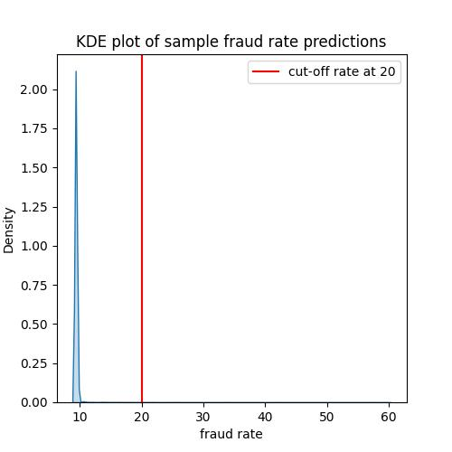



Fraud Rate Prediction
Validation $R^{2}$ Score
0.7908
Test $R^{2}$ Score
0.7879
We eliminated transactions with top 0.1% of predicted fraud probability, which is about 16,000 transactions.

Slide 9


"Despite the wide variety of techniques available for grouping individuals into market segments on the basis of multivariate survey information, clustering remains the most popular and most widely applied method." - Australasian Journal of Market Research
Clustering Merchants
Background Info
Missing merchant information
381 out of 4380 are unknown merchants!!!
3 ~ 5 Market Segmentations

Slide 10

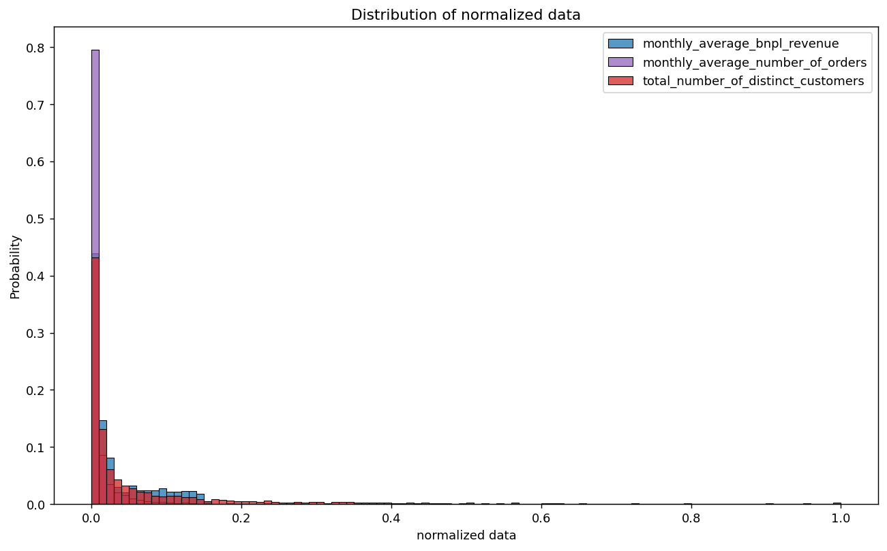
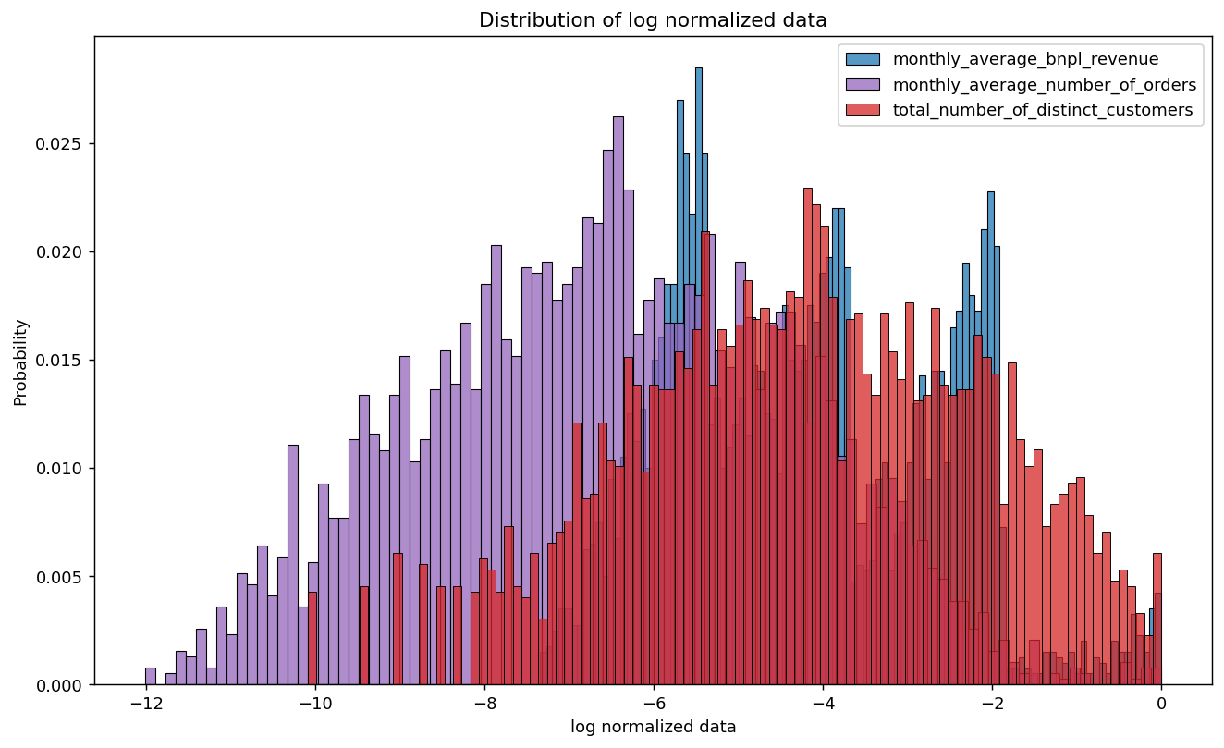
Features
log monthly revenue
log monthly number of orders
log total distinct customers

Slide 11
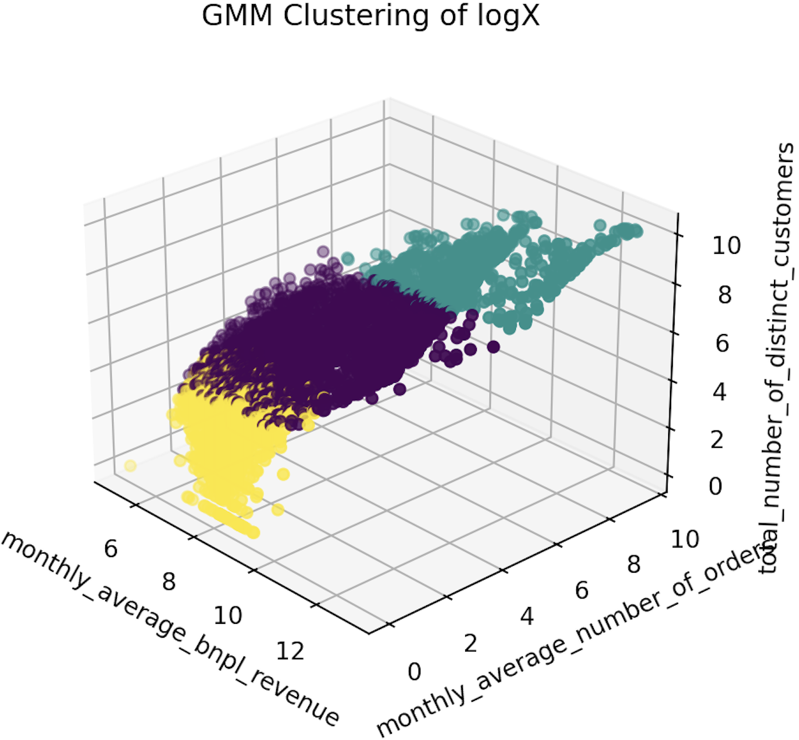
Clustering Analysis
K-means K-means
Gaussian Mixture model GMM
Density-based spatial clustering of applications with noise DBSCAN
Mean shift Mean Shift

Slide 12
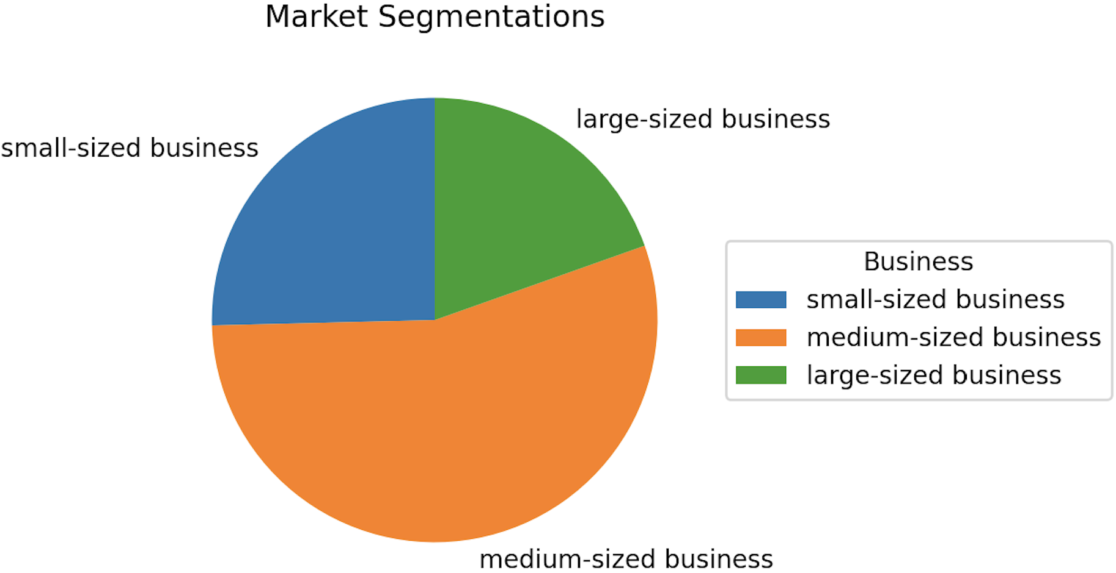
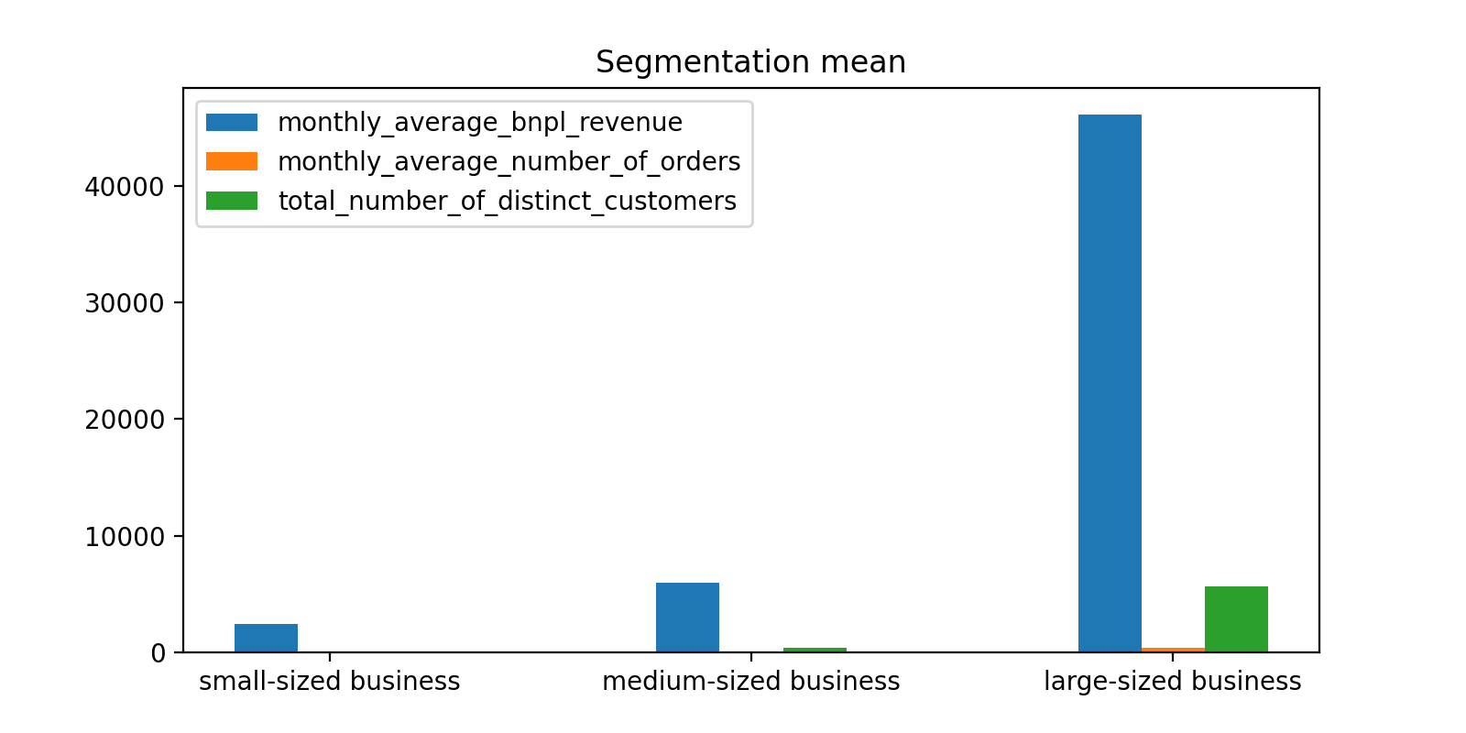
Business Data Chart
1,112
2,414
854
In a month,
their revenue: $2,452
their number of orders: 2
their historical total distinct customers: 21
In a month,
their revenue: $5,981
their number of orders: 21
their historical total distinct customers: 381
In a month,
their revenue: $46,079
their number of orders: 386
their historical total distinct customers: 854

Slide 13

Final Ranking Algorithm
Computing Top 100 Merchants list

Slide 14
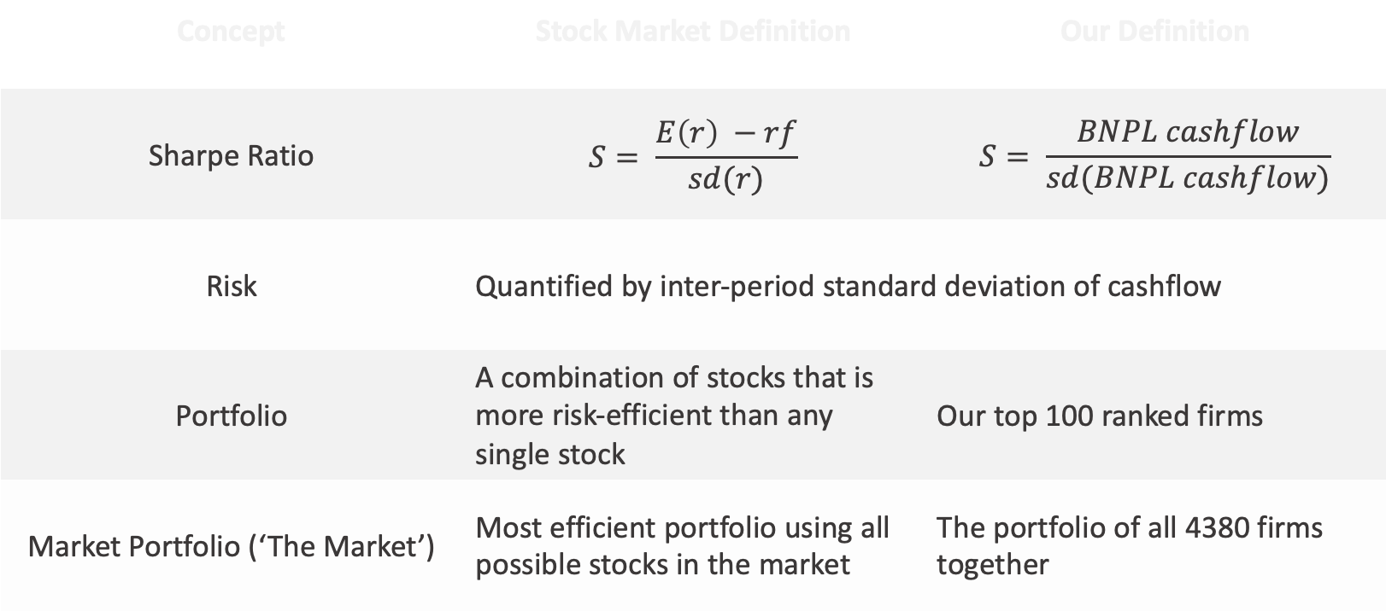
Related Finance Theory and Assumptions
Concept | Stock Market Definition | Our Definition
Sharpe Ratio | $$S= \frac{E\left(r\right) −rf}{sd(r)}$$ | $$S= \frac{BNPL cashflow}{sd(BNPL cashflow)}$$
Risk | Quantified by inter-period standard deviation of cashflow
Portfolio | A combination of stocks that is more risk-efficient than any single stock | Our top 100 ranked firms
Market Portfolio (‘The Market’) | Most efficient portfolio using all possible stocks in the market | The portfolio of all 4380 firms together

Slide 15

Final Algorithm
Our Ranking System
Methodology
Find the optimal coefficients using the “Sharpe Ratio”
To find the 100 merchants that from the portfolio giving the highest Future Benefit
Use a Linear Heuristic Function
$$Merchant^{′}s Score=∑(coef_{i}∗variable_{i})$$
*we will soon discuss variables
Benefit Score feedback
Training
(Past)
Validation
(future)
Rank the merchants based on scores
Try combination of coef.
Form portfolio of top 100 scoring merchants
Ranking for portfolio and feeds in

Slide 16
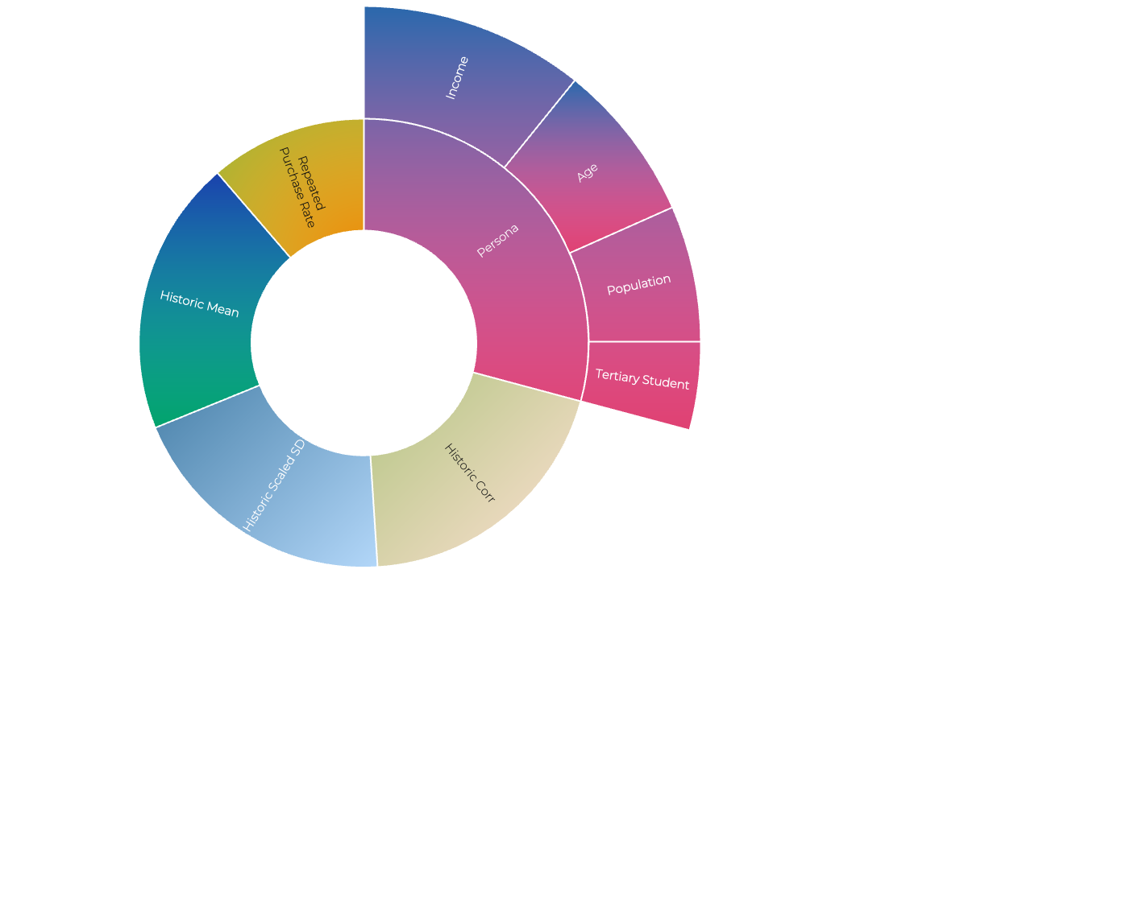
Features We Employ…

Slide 17
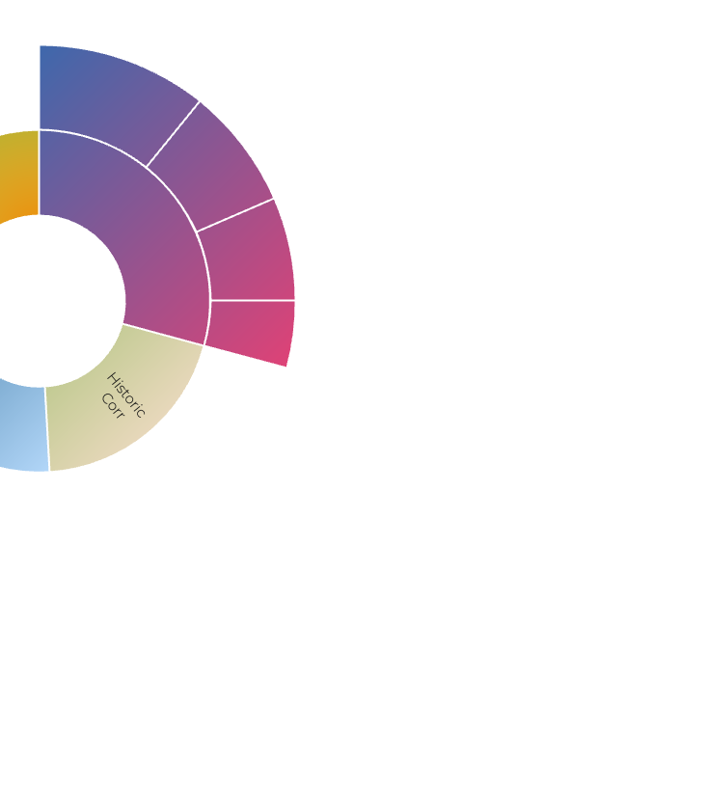
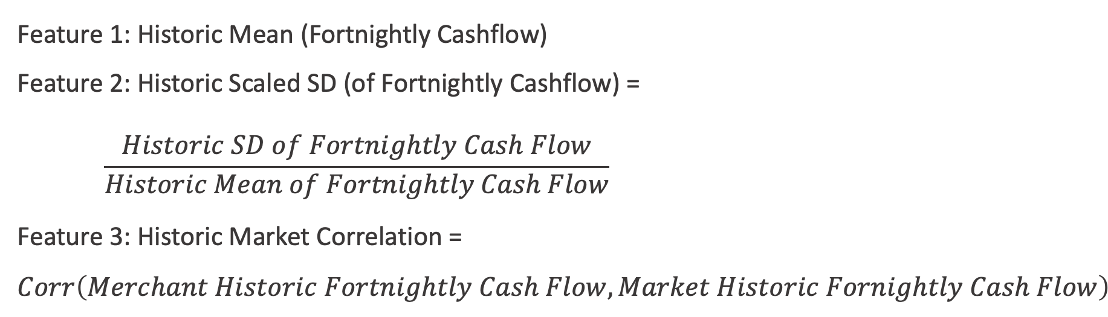
Feature 1-3
Cash Flow
Feature 1: Historic Mean (Fortnightly Cashflow)
Feature 2: Historic Scaled SD (of Fortnightly Cashflow) =
$$\frac{Historic SD of Fortnightly Cash Flow}{Historic Mean of Fortnightly Cash Flow}$$
Feature 3: Historic Market Correlation = $Corr\left(Merchant Historic Fortnightly Cash Flow, Market Historic Fornightly Cash Flow\right)$

Slide 18
Feature 4
Repeated Purchase Rate
$\text{Repeated} \text{Purchase} \text{Rate}\text{ = }\frac{\# Customers with multiple purchases in the merchant}{\# Customers with purchases in the merchant}$
Transactions With Varying Dollar Values Which Would Likely Induce Growth in the Future
Merchants With Low Repeated Purchase Rates are More Likely to Have Exposure to Distinct Customers

Slide 19
Age
+
Student
Income
Postcode Population
Feature 5
Persona Score

Slide 20
PERSONA FEATURE 1+2:
Age
Student
Higher Chance of Impulsive Buying
Potential High-income Audience in the Future
More Open-minded to E-commerce Product
Bring More Sustainable Business Opportunities to Our Firm

Slide 21
"after controlling for age, income is the most important determinant of variations in credit scores”
Credit Growth and the Financial Crisis: A New Narrative
PERSONA FEATURE 3:
High Income
Able to Repay Regularly
Bring Stable Cash Flow

Slide 22

PERSONA FEATURE 4:
Postcodes with Large Population
Encourages Postcodes with More People

Slide 23

Result

Slide 24
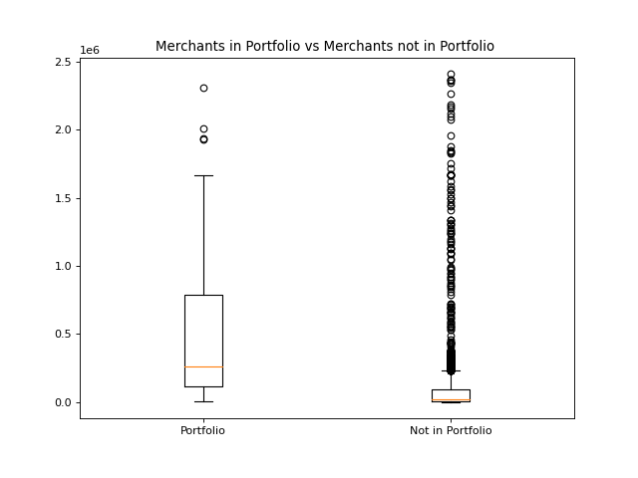
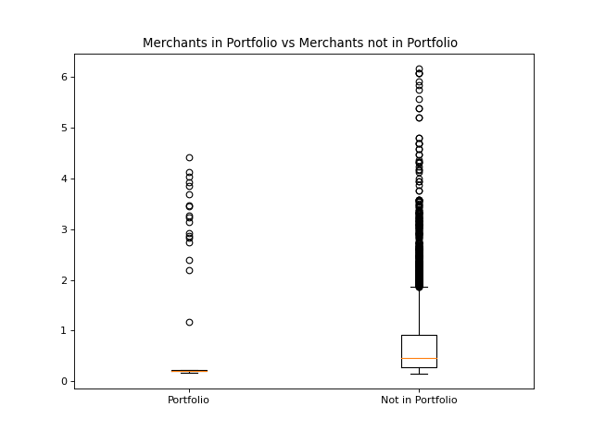
Historic Mean Fortnightly Cash Flow
$
Historic Scaled SD Fortnightly Cash Flow
262,924
0.46
21,581
0.21
Portfolio Merchants vs Not in Portfolio Merchants

Slide 25
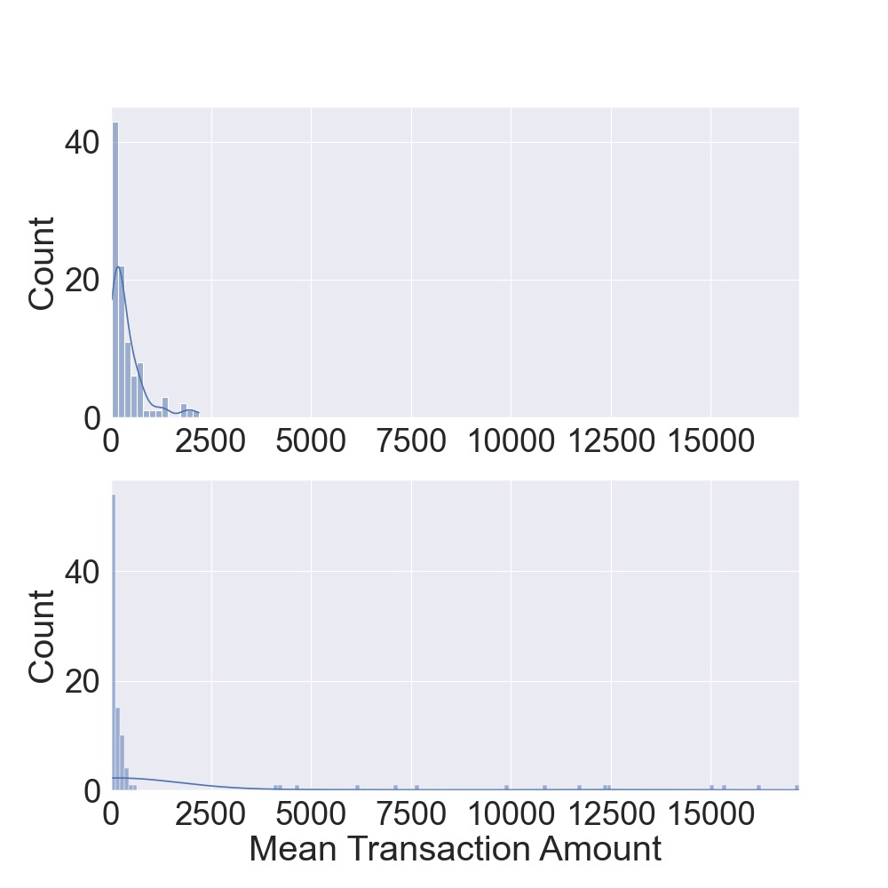
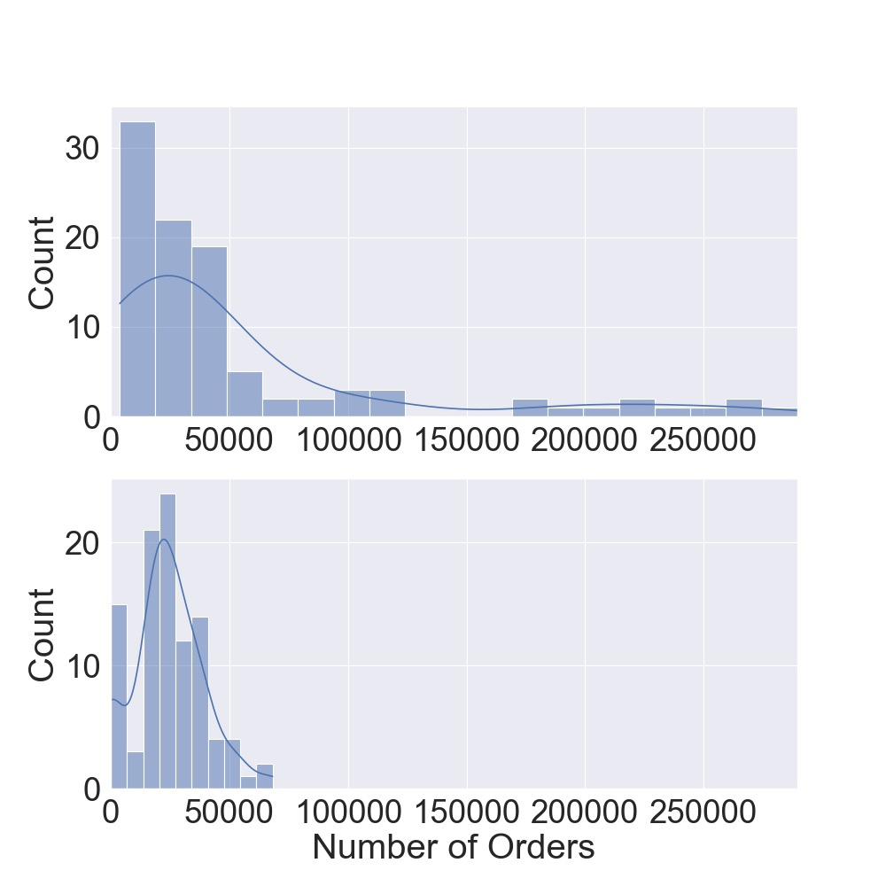
Intuition About BNPL Preferred Merchants
Three Variables
Five Variables
Mean transaction amount of firms
Number of orders

Slide 26
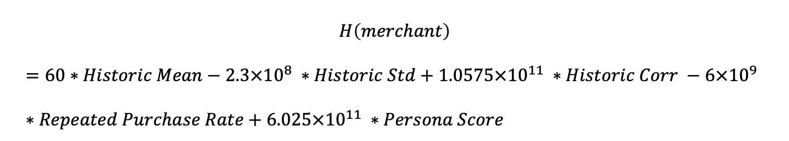
Final Model Result
RANKING | MERCHANT
1 | UNNAMED (ABN: 57564805948)
2 | Non Egestas PC (ABN: 31400548982)
3 | UNNAMED (ABN: 49465266764)
4 | UNNAMED (ABN: 62789659343)
5 | Cras Convallis Ltd (ABN: 99801770627)
6 | Sed Facilisis Vitae Incorporated (ABN: 10881038707)
7 | Hendrerit Id Ante Corp. (ABN: 49514806178)
8 | Vulputate Risus A Corporation (ABN: 48549026640)
9 | UNNAMED (ABN: 29215623643)
10 | Mauris Blandit Limited (ABN: 81548651453)
… (more refer to the appendix)
Five variable heuristic function
$$H\left(merchant\right)$$
$$=60∗Historic Mean−2.3×{10}^{8} ∗Historic Std+1.0575×{10}^{11} ∗Historic Corr −6×{10}^{9} ∗Repeated Purchase Rate+6.025×{10}^{11} ∗Persona Score$$

Slide 27
Small Business
Final Model Analysis
Medium Business
Large Business
Ranking | Merchant
1 | Unnamed, abn: 57564805948
2 | Non Egestas PC, abn: 31400548982
3 | Unnamed, abn: 49465266764
4 | Unnamed, abn: 49465266764
5 | Cras Convallis Ltd, abn: 99801770627
6 | Sed Facilisis Vitae Incorporated, abn: 99801770627
: :
Medium Business

Slide 28
Small Business
Final Model Analysis
Large Business
Large Business
Ranking | Merchant
11 | Magnis Foundation, abn: 89640578182
14 | Aliquet Phasellus Consulting, abn: 37459245212
18 | Cum Sociis Natoque Incorporated, abn: 50866797623
20 | Enim Etiam Industries, abn: 88547577701
21 | Ipsum Company, abn: 30122382323
22 | Mollis Dui In LLP, abn: 61447419161
Medium Business
:
:

Slide 29
Small Business
Final Model Analysis
Small Business
Large Business
Ranking | Merchant
23 | Unnamed, abn: 20562405782
72 | Unnamed, abn: 29566626791
76 | Unnamed, abn: 74648589246
80 | Unnamed, abn: 75342681786
83 | Unnamed, abn: 33604812025
94 | Unnamed, abn: 79953723663
: :
Medium Business

Slide 30

Limitations
Potential for Overfitting
Limited Resources and data provided

Slide 31
Bibliography
https://scikit-learn.org/stable/modules/generated/sklearn.ensemble.RandomForestRegressor.html
https://www.youtube.com/watch?v=J4Wdy0Wc_xQ&t=4s
https://risnews.com/raising-bar-revenues-and-loyalty-buy-now-pay-later-solutions
https://www.ncbi.nlm.nih.gov/pmc/articles/PMC9198328/
https://www.ncoss.org.au/wp-content/uploads/2021/09/Young-People-and-BNPL_NCOSS-Cost-of-Living-in-NSW-Report_September-2021_FINAL.pdf
https://asic.gov.au/regulatory-resources/find-a-document/reports/rep-600-review-of-buy-now-pay-later-arrangements/
https://ro.uow.edu.au/commpapers/139/

